Slide 1



TEAM MEMBERS:
20DCE019 - Yatharth Chauhan
20DCE017 - Raj Chauhan
20DCE024 – Deep Dhaduk
INSTRUCTOR:
Prof. Dhruvi Gosai
PROJECT TITLE: BLOOD DONATION CENTER
SEMESTER - 3
CLASS – DEPSTAR CE – 1
BATCH - A

Slide 2
Blood Donation Center

Slide 3
OUTLINE
Introduction
Problem Statement
Am I Acceptable Donor?
Software and Hardware Requirements
Data Flow Diagram
Entity – Relationship Diagram
Timeline Chart
Output of Project
Team Presentation

Slide 4
INTRODUCTION
The main aim of this project is to save lives of people by providing blood.
Our project Online Blood Donation Center Website.
This website reduces the time to a greater extent that is searching for the required blood.
Thus this application provides the required information in less time and also helps in quicker decision making.

Slide 5
STATEMENT OF THE PROBLEMS
The major problem in Blood Donation systems was that, they don’t follow the actual needs of users.
Traditional blood donation systems were developed by 1 or 2 perspective.
There was shortage and sometimes unavailability of rare blood groups due to less modules i.e. patient and donors.

Slide 6
AM I ACCEPTABLE DONOR?
Be at lest 17 years old
Weight at least 110 lbs
Be in good health
Know the names of any medicines you have recently taken
Have recently eaten a good meal

Slide 7
SOFTWARE REQUIREMENT SPECIFICATION
Hardware Requirements
Processor : 1.2 Ghz or More
RAM: 1 Gb or More
HardDisk: 80 Gb or More
Software Requirements:
Operating System: Windows XP, 7, 8, 10
Web Browser: Explorer, Firefox, Google Chrome
Language Used: PHP, CSS, Javascript, MYSQL, Bootstrap, Jquery, Ajax

Slide 8
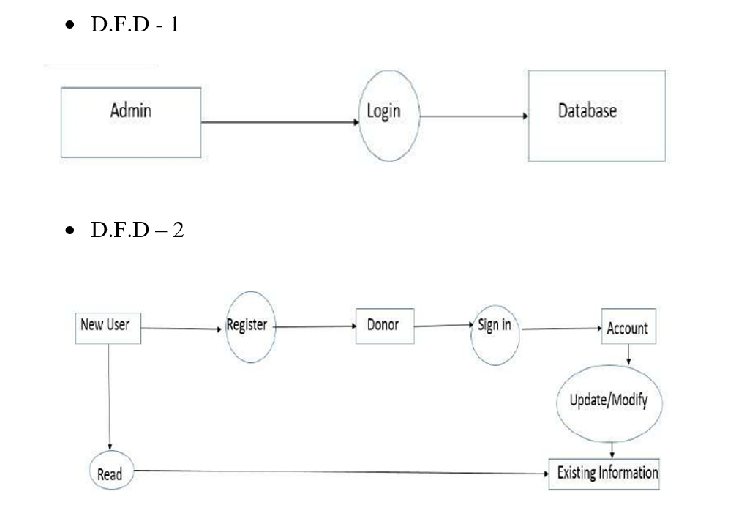
DATA FLOW DIAGRAM

Slide 9
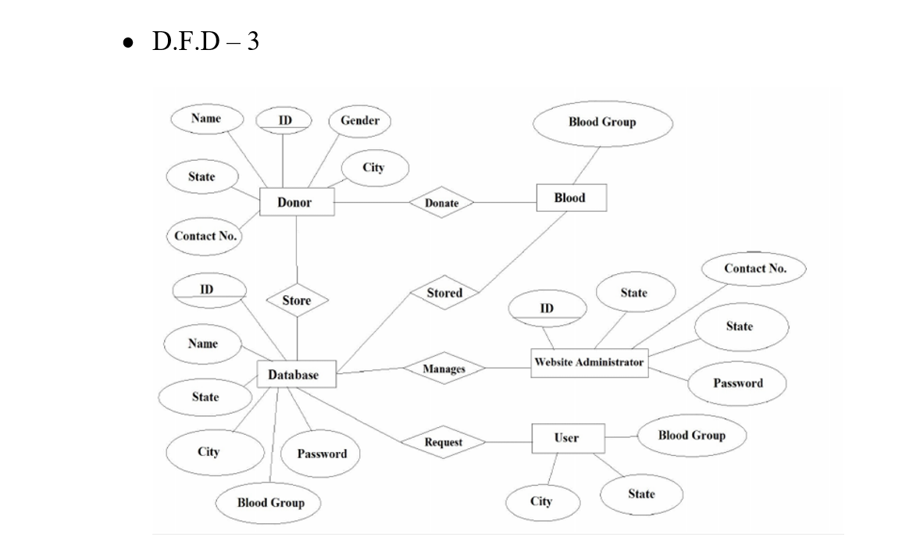
ENTITY - RELATIONSHIP DIAGRAM

Slide 10
GANTT CHART
08
AUGUST
09
SEPTEMBER
10
OCTOBER
11
NOVEMBER
W1
W2
W3
W4
W1
W2
W3
W4
W1
W2
W3
W4
W1
W2
W3
W4
PROJECT PLAN , MOTIVATION, IDEA, IMPLEMENTATION
PROJECT BUILDING(FROM SCRATCH TO A RESPONSIVE FRAME)
ADDING NEW FEATURES TO THE LIBRARY(PROJECT TOOLS)
PROJECT TESTING AND BUG FIXING
PROJECT DEPLOYMENT AND FINALISATION

Slide 11
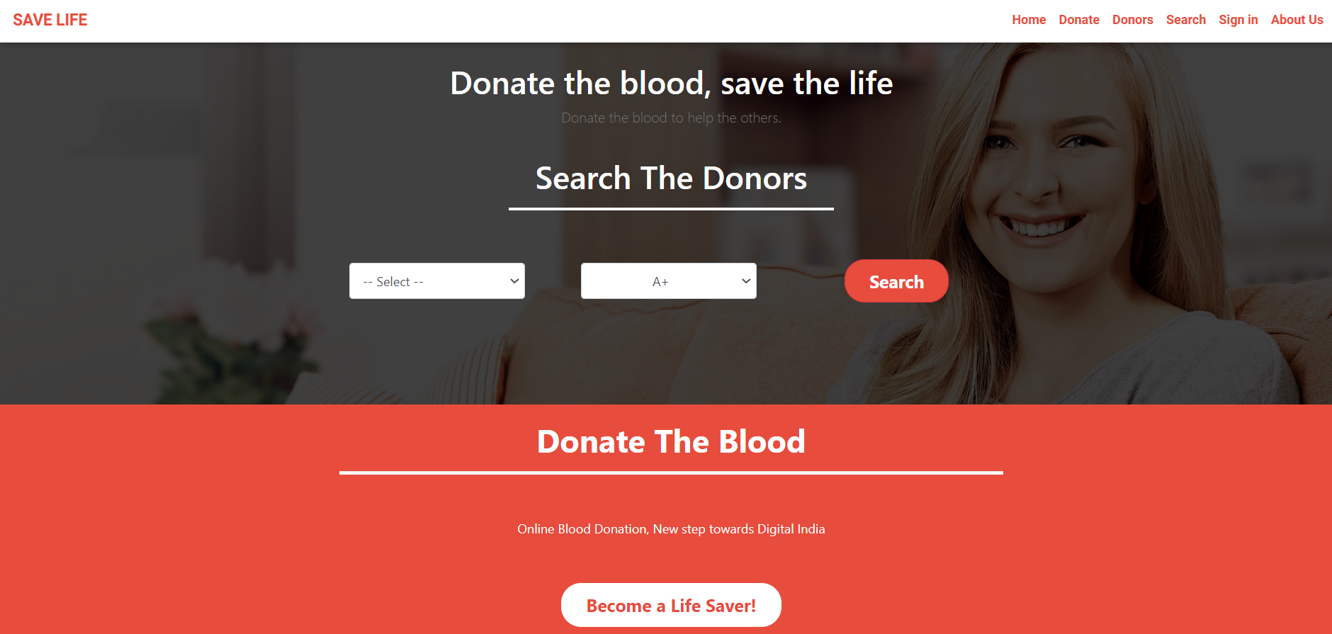
HOME PAGE

Slide 12
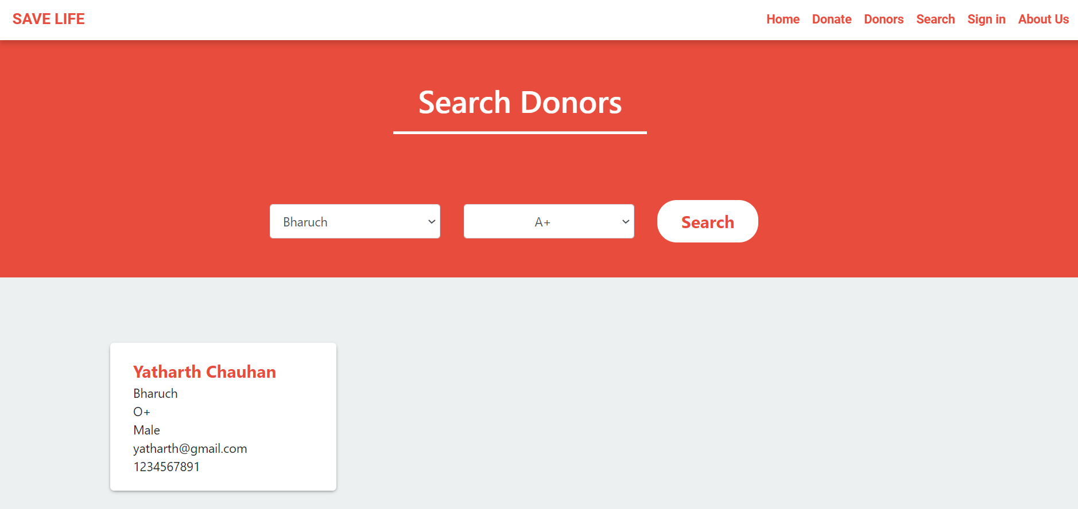
SEARCH PAGE

Slide 13
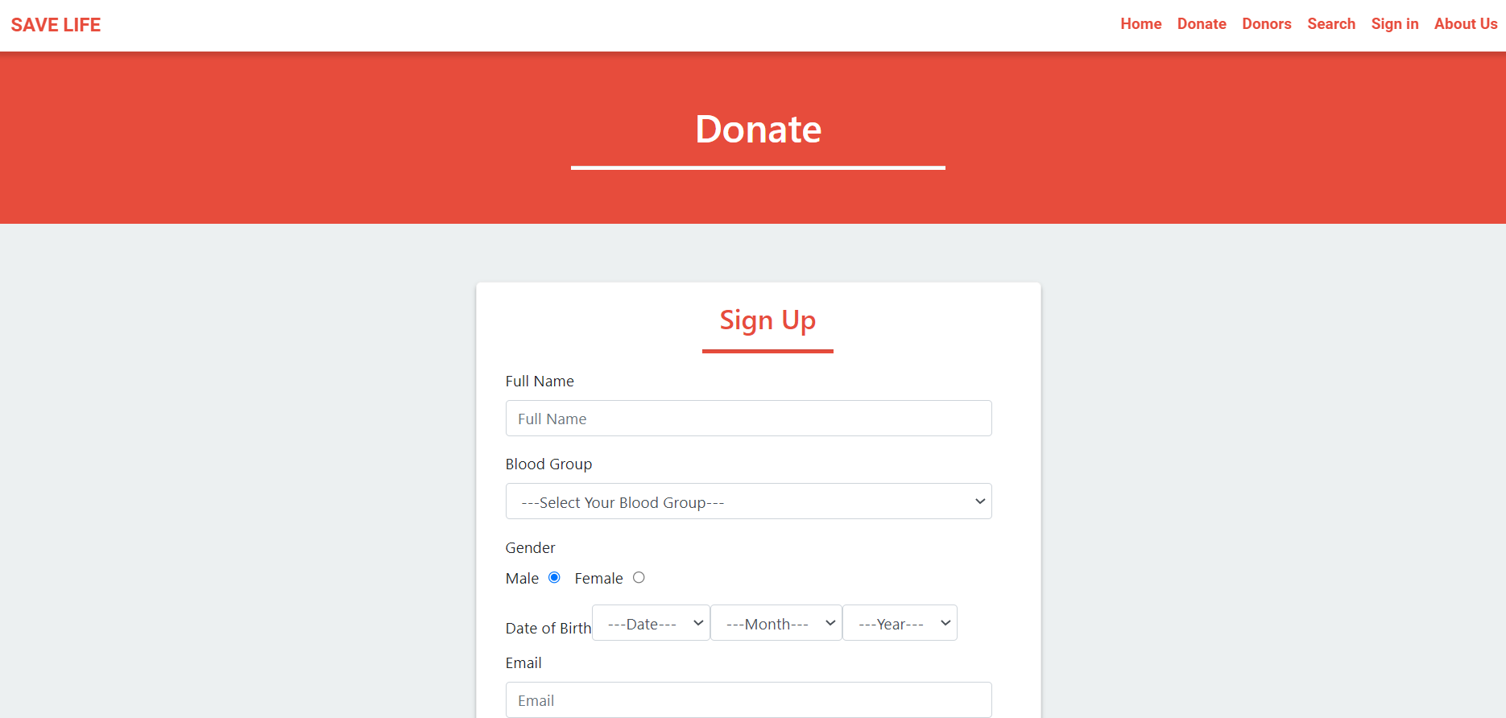
SIGN UP PAGE

Slide 14
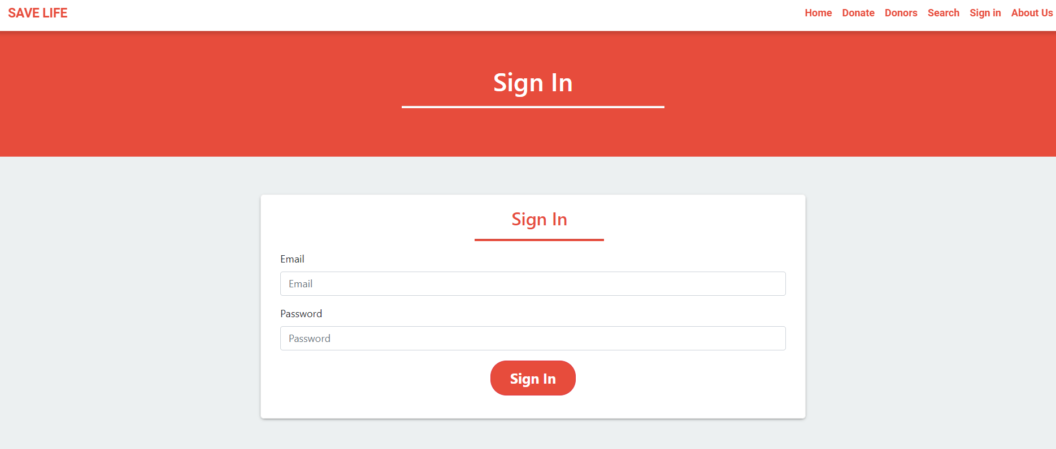
SIGN IN PAGE

Slide 15
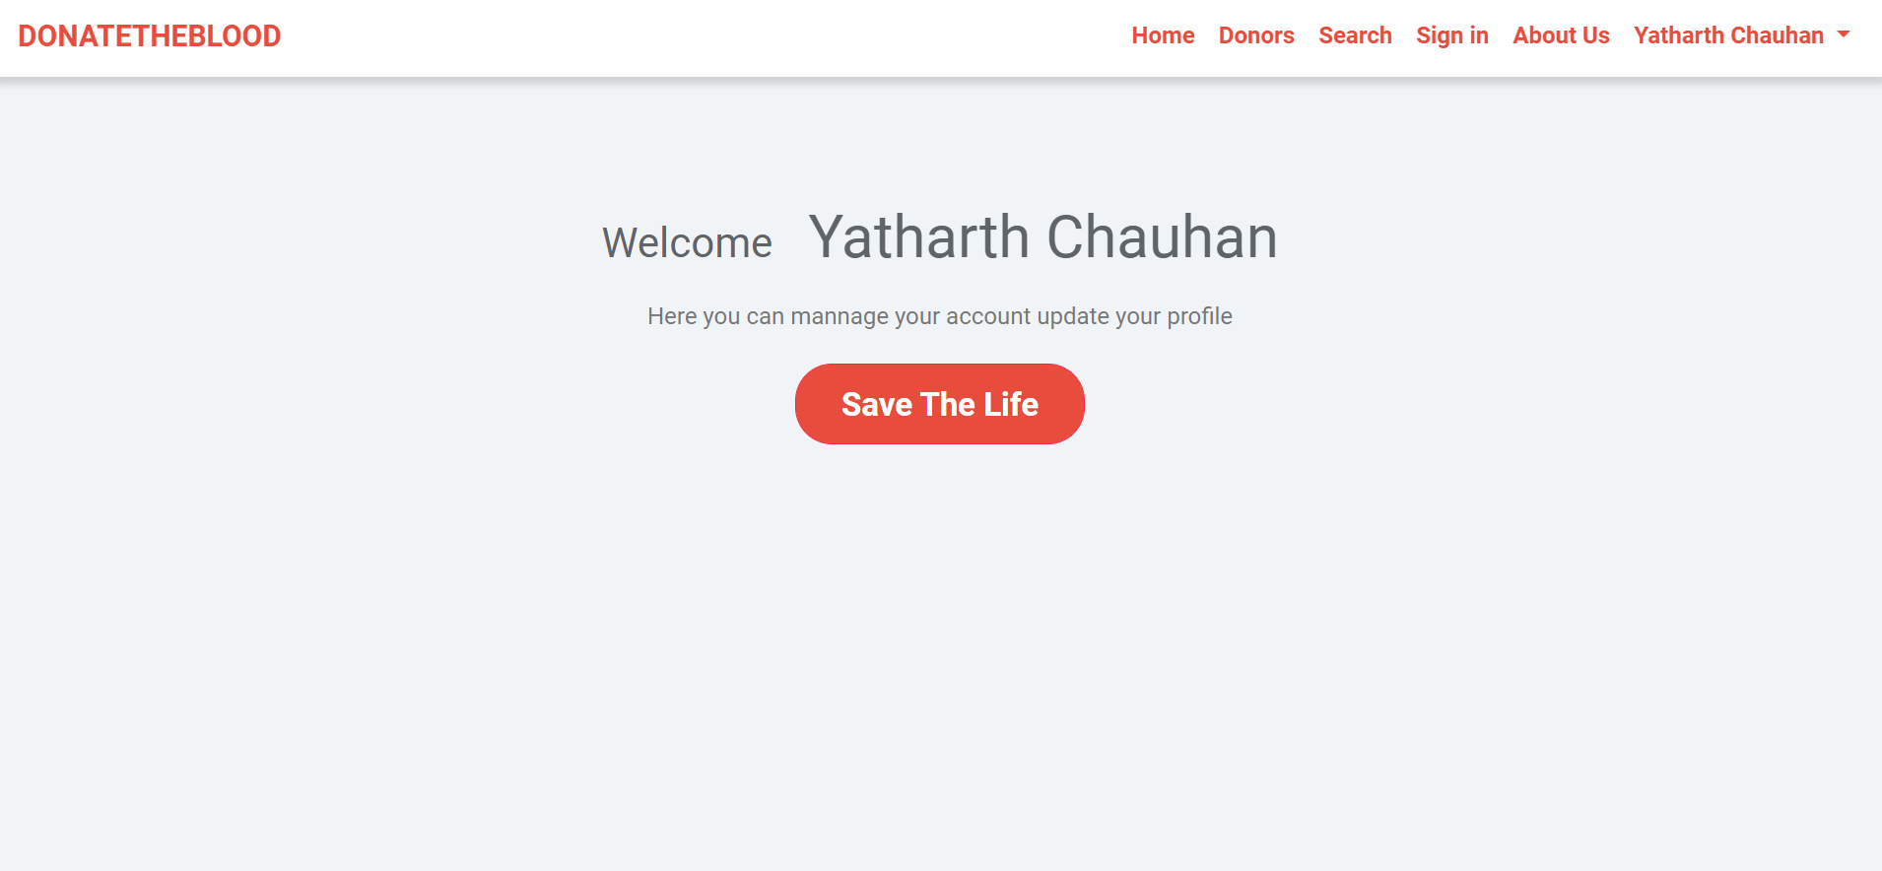
AFTER SIGN IN (NOT DONATED BLOOD)

Slide 16
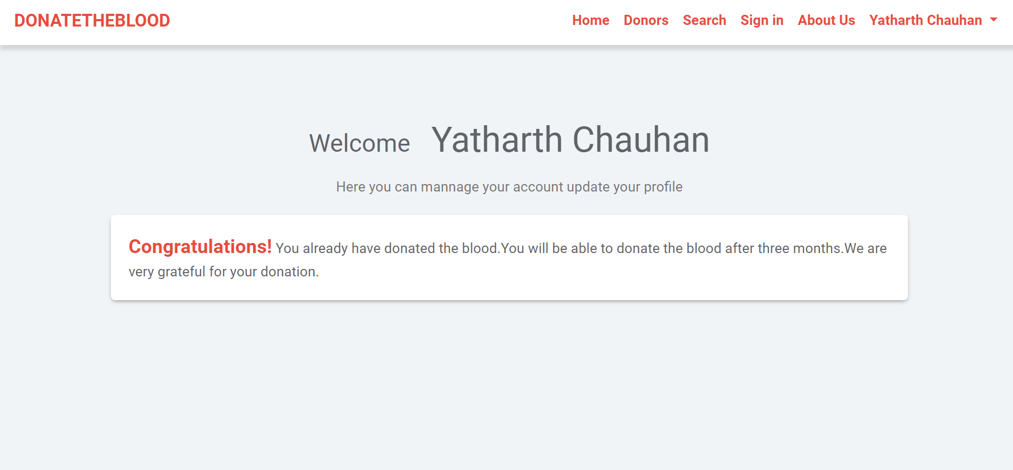
AFTER SIGN IN CLICK ON SAVE LIFE (DONATED BLOOD)

Slide 17
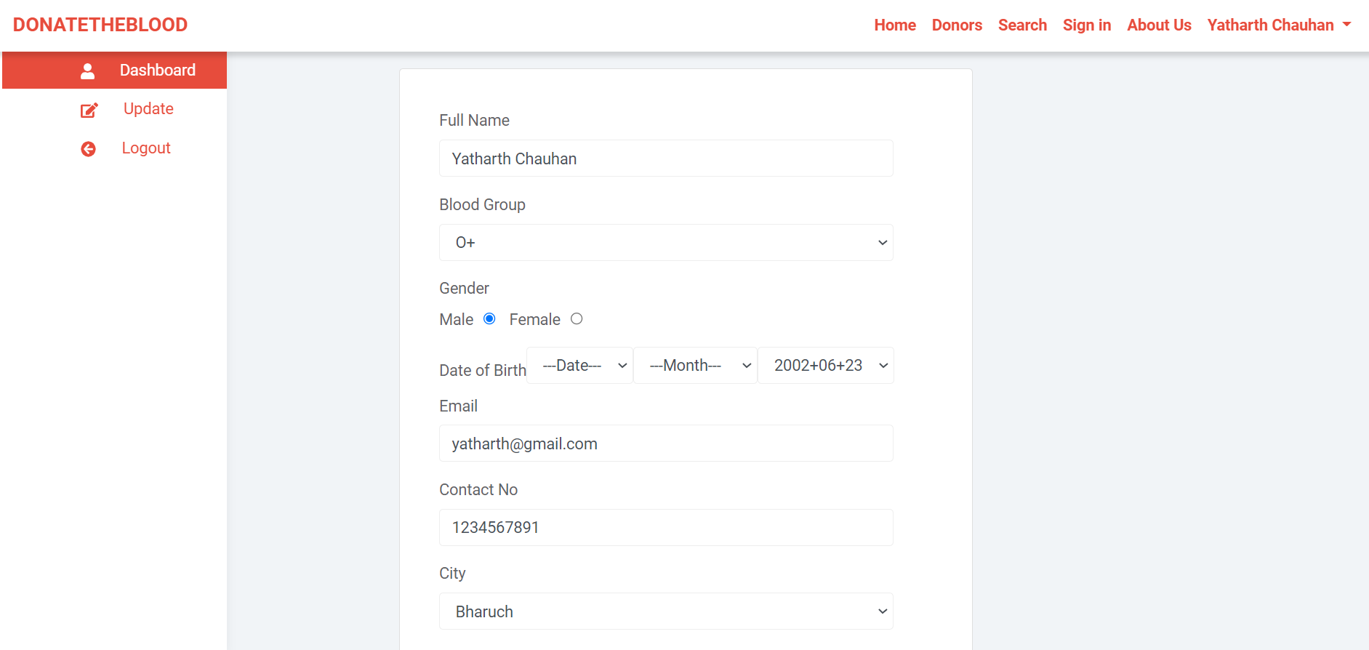
DASHBOARD

Slide 18
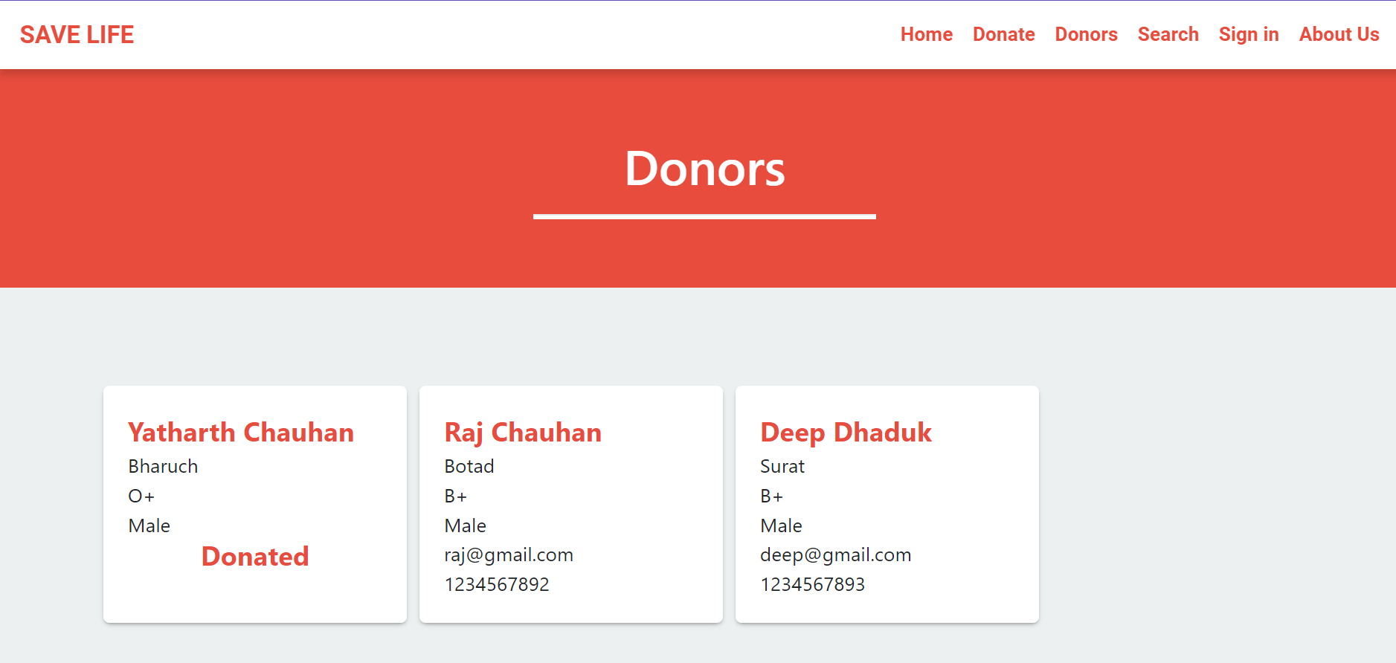
DONORS DETAILS PAGE

Slide 19
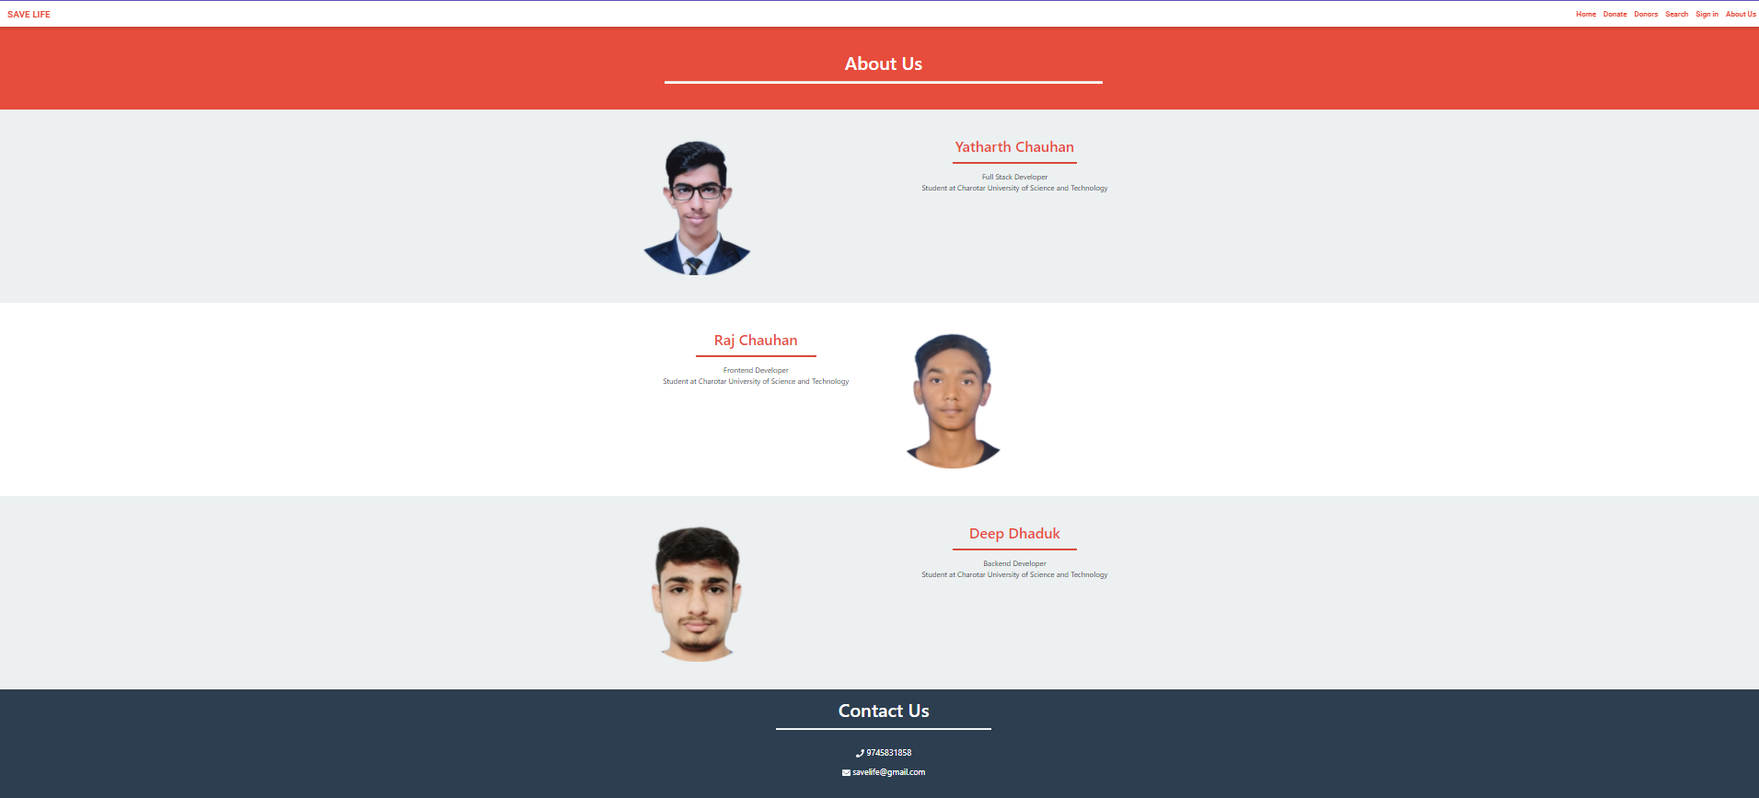
ABOUT US PAGE

Slide 20
CONCLUSION
This report presents THE BANK DONATION related issues.
The objectives of project is implemented by implmenting the differents plans such as time estimated through Timeline chart, work background,flowchart etc...
online blood donation system make work easy, and ensures fast retrieval of data when needed.

Slide 21
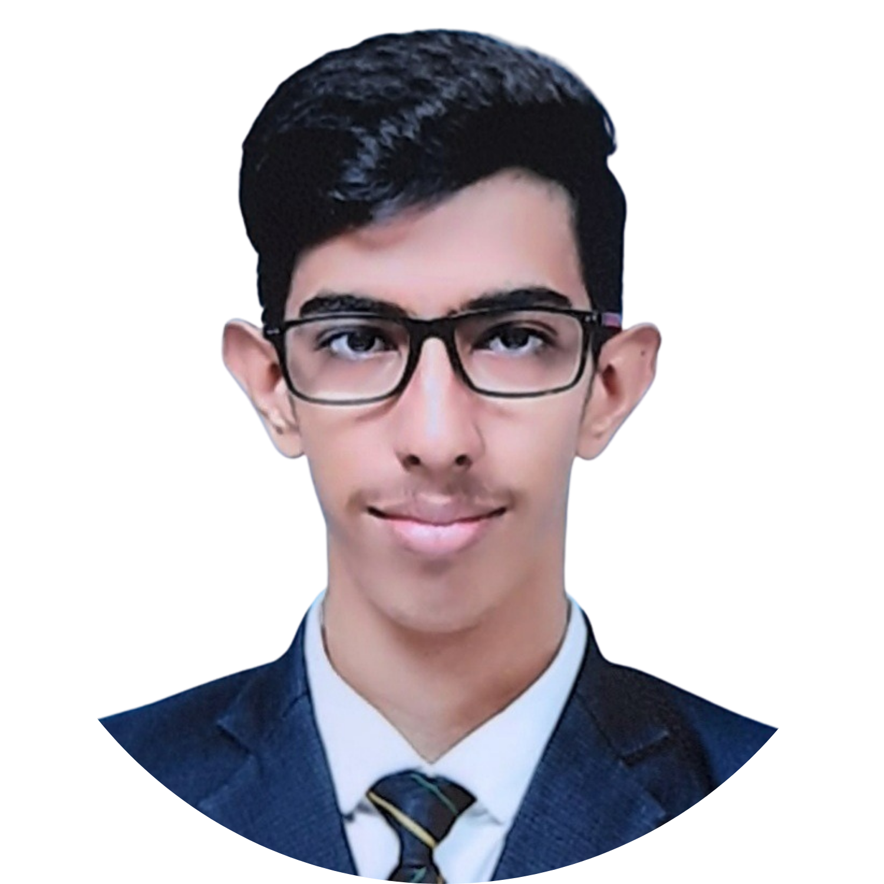
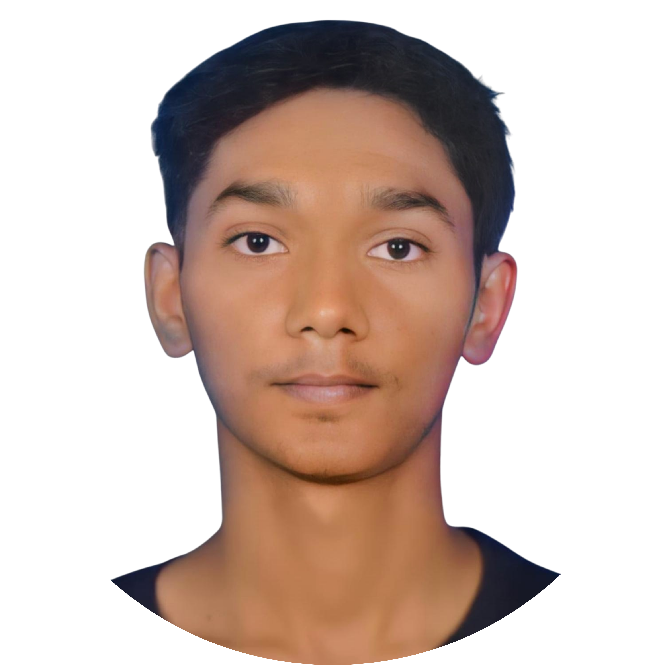
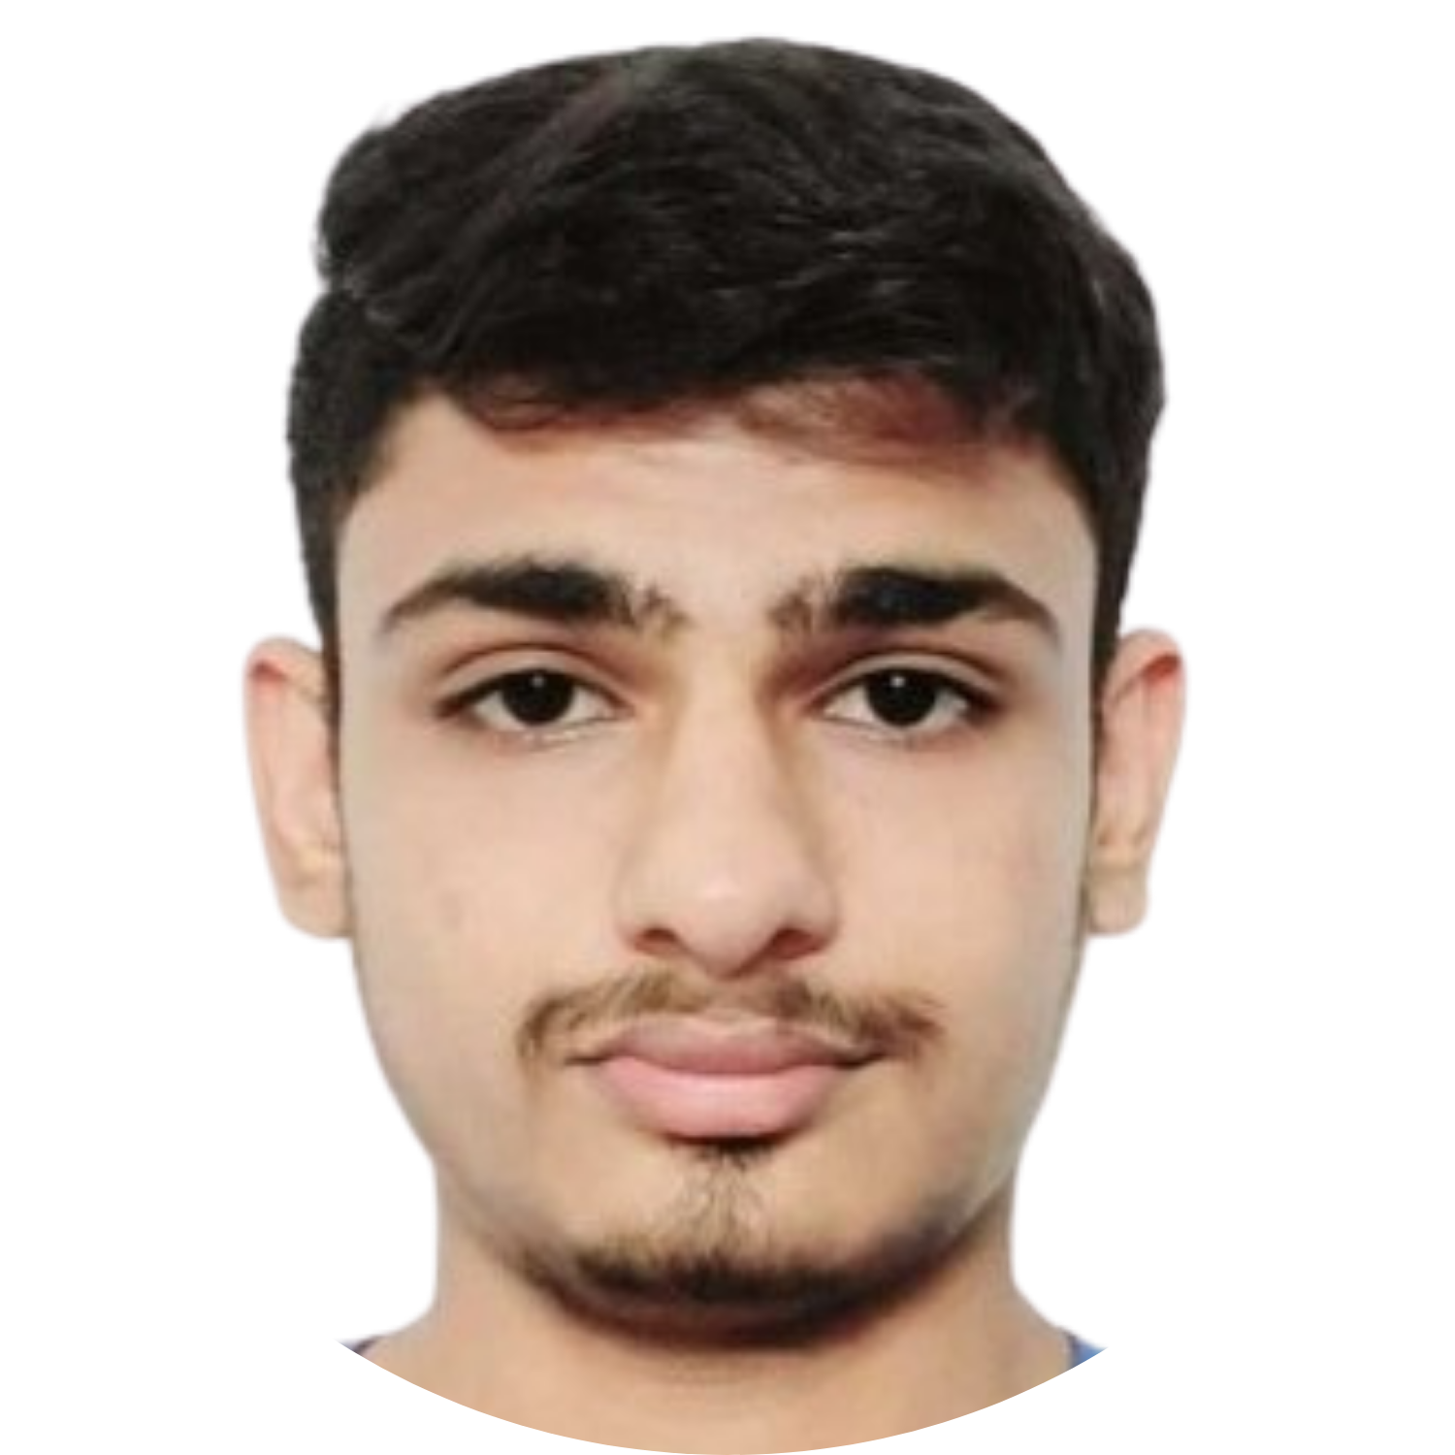
TEAM PRESENTATION
YATHARTH CHAUHAN
Full Stack Developer JOB TITLE
Blue is the colour of the clear sky and the deep sea
RAJ CHAUHAN
Frontend
Developer
DEEP DHADUK
Backend
Developer

Slide 22
THANKS!
savelife@gmail.com +91 1234567891 savelife.com

